Slide 1
Make Interactive Videos with PowerPoint and Office Mix

Slide 2

First download Office Mix, a free PowerPoint add-in
Tip: Press Shift+F5 to make this link clickable.
With Office Mix you can:
1
Insert videos, polls, and other interactive content into your presentation.
Record your voice and draw on your slides while you present.
Share your Mix online—it plays back on any device.
Track how people use your Mix.
Get Office Mix
2
CLICK TO DOWNLOAD
3
4

Slide 3

After you install Office Mix…
Get started!
1
Open PowerPoint.
Explore the tools on the new Mix tab—they’re just a tap away.
2

Slide 4
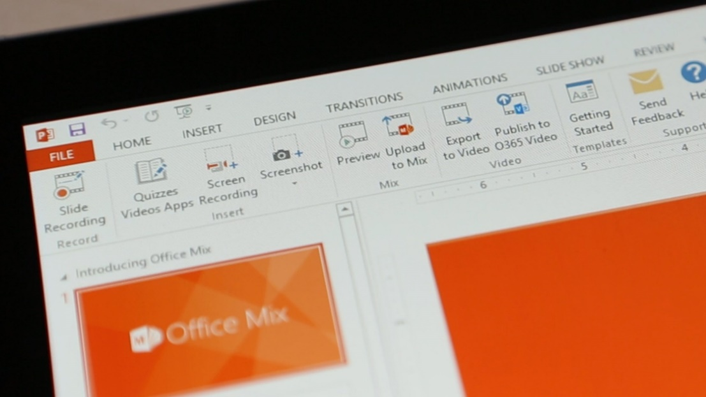
See for yourself
In this short video, you’ll learn how to:
Tip: Press Shift+F5 to make this link clickable.
Install Mix
Record audio, video, and ink
Securely upload and share your video
CLICK TO SEE THIS
MIX IN YOUR BROWSER

Slide 5
Learn more at mix.office.com
Get Office Mix

